Slide 1

Chapter 1
Software Engineering Principles

Slide 2
The Software Life Cycle
Problem analysis
Requirements elicitation
Software specification
High- and low-level design
Implementation
Testing and Verification
Delivery
Operation
Maintenance

Slide 3
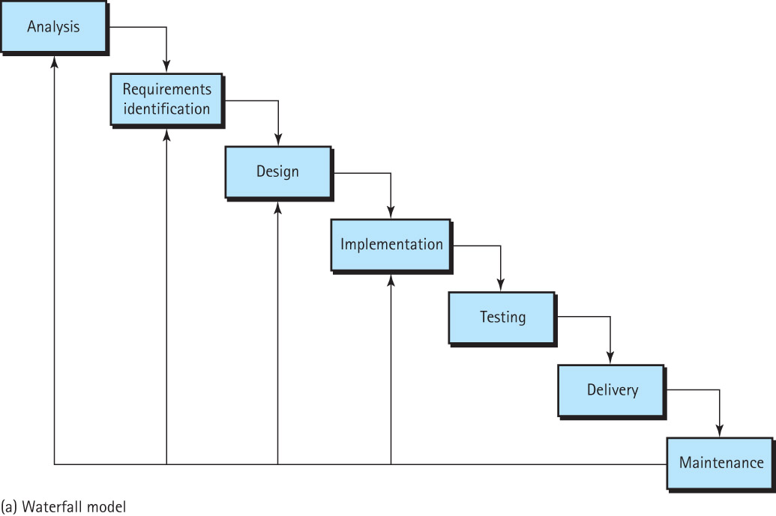
Waterfall Model

Slide 4
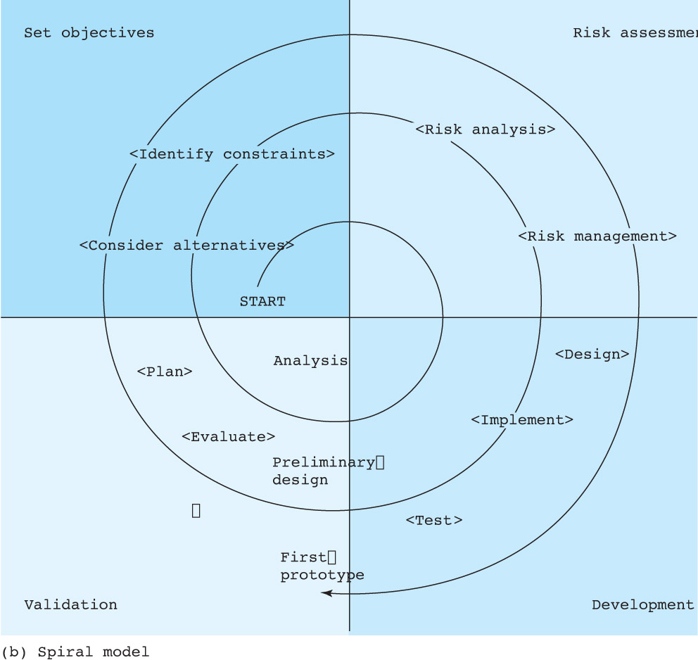
Spiral Model

Slide 5
Software Engineering
A disciplined approach to the design, production, and maintenance of computer programs
that are developed on time and within cost estimates,
using tools that help to manage the size and complexity of the resulting software products.

Slide 6
An Algorithm Is . . .
A logical sequence of discrete steps that describes a complete solution to a given problem computable in a finite amount of time.

Slide 7
Programmer ToolBoxes
Hardware—the computers and their peripheral devices
Software—operating systems, editors, compilers, interpreters, debugging systems, test-data generators, and so on
Ideaware – shared body of knowledge

Slide 8
Goals of Quality Software
It works.
It can be modified without excessive time and effort.
It is reusable.
It is completed on time and within budget.

Slide 9
Detailed Program Specification
Tells what the program must do, but not how it does it.
Is written documentation about the program.

Slide 10
Abstraction
A model of a complex system that includes only the details essential to the perspective of the viewer of the system.
Programs are abstractions.

Slide 11

Abstraction (cont.)

Slide 12
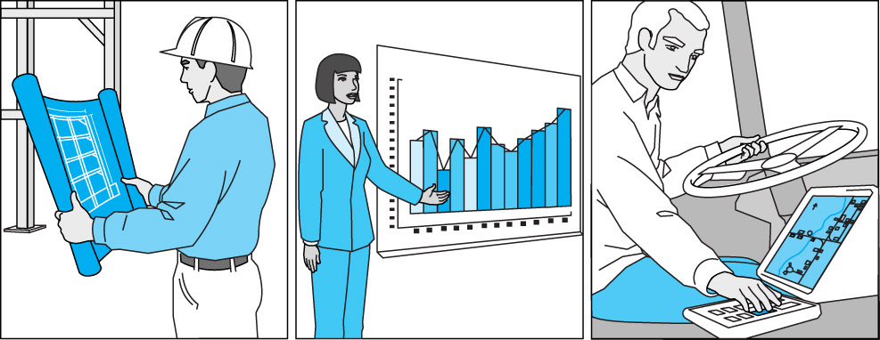
Visual Tools

Slide 13
Information Hiding
The practice of hiding the details of a module with the goal of controlling access to the details from the rest of the system.
A programmer can concentrate on one module at a time.
Each module should have a single purpose or identity.

Slide 14
Stepwise Refinement
A problem is approached in stages. Similar steps are followed during each stage, with the only difference being the level of detail involved. Some variations:
  Top-down
  Bottom-up
  Functional decomposition
  Round-trip gestalt design

Slide 15
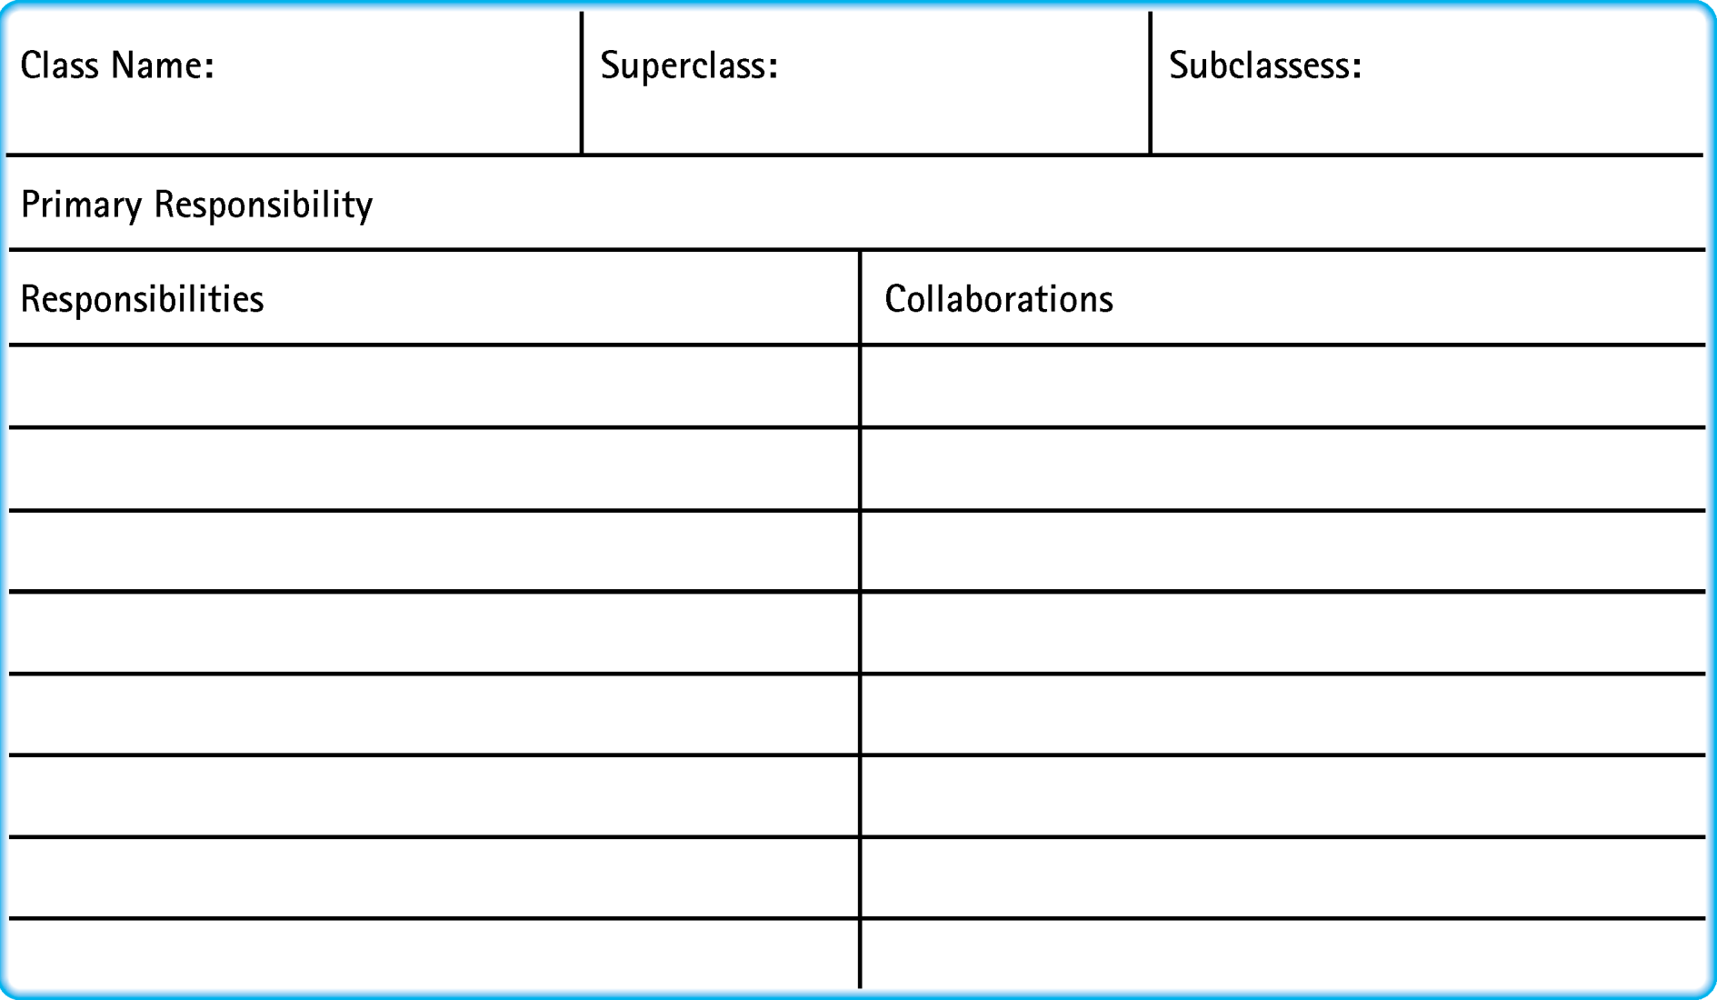
Visual Aids – CRC Cards

Slide 16
Procedural vs. Object-Oriented Code
“Read the specification of the software you want to build. Underline the verbs if you are after procedural code, the nouns if you aim for an object-oriented program.”
Grady Booch, “What is and Isn’t Object Oriented Design,” 1989.

Slide 17
Two Approaches to
Building Manageable Modules
FUNCTIONAL
DECOMPOSITION
OBJECT-ORIENTED
DESIGN
Divides the problem
into more easily handled
subtasks, until the
functional modules
(subproblems) can
be coded.
Identifies various
objects composed of
data and operations,
that can be used
together to solve
the problem.
FOCUS ON: processes FOCUS ON: data objects

Slide 18
Functional Design Modules
Main
Prepare
File for
Reading
Get Data
Find
Weighted
Average
Print
Weighted
Average
Print Data
Print Heading

Slide 19
Object-Oriented Design
A technique for developing a program in which the solution is expressed in terms of objects -- self- contained entities composed of data and operations on that data.
cin
cout
>>
<<
get
Private data
setf
Private data
.
.
.
.
.
.
ignore

Slide 20
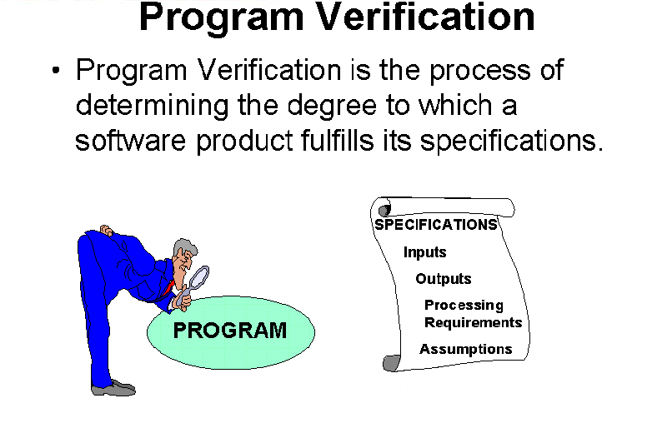
Testing

Slide 21
Verification vs. Validation
Program verification asks,
“Are we doing the job right?”
Program validation asks,
“Are we doing the right job?”
B.W. Boehm, Software Engineering Economics, 1981.

Slide 22
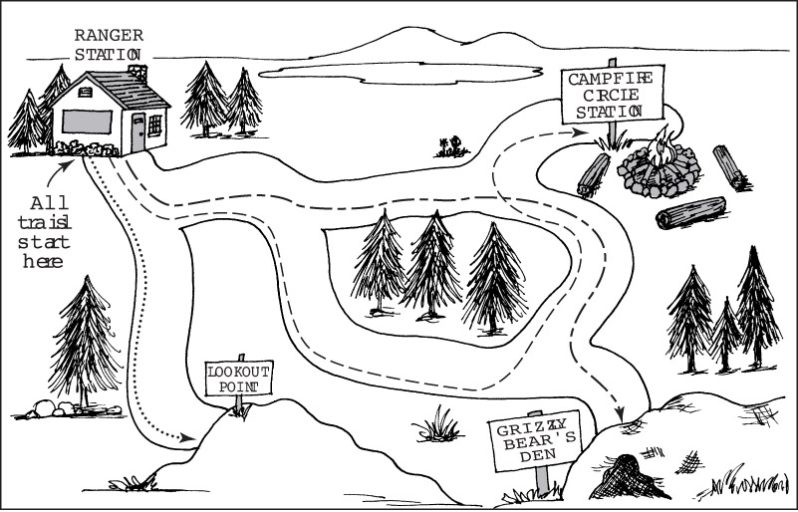

Slide 23
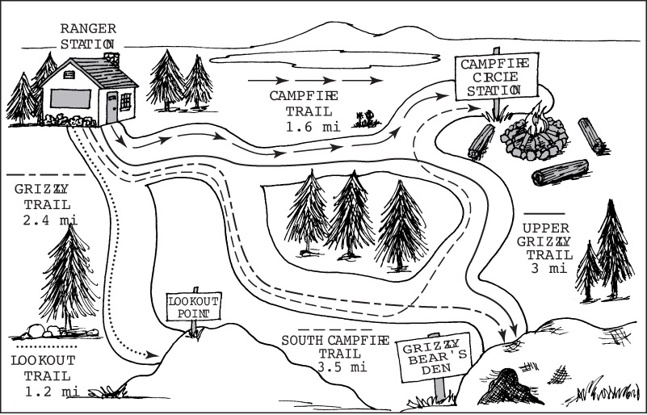

Slide 24
Types of Errors
Specification
Design
Coding
Input

Slide 25


Slide 26
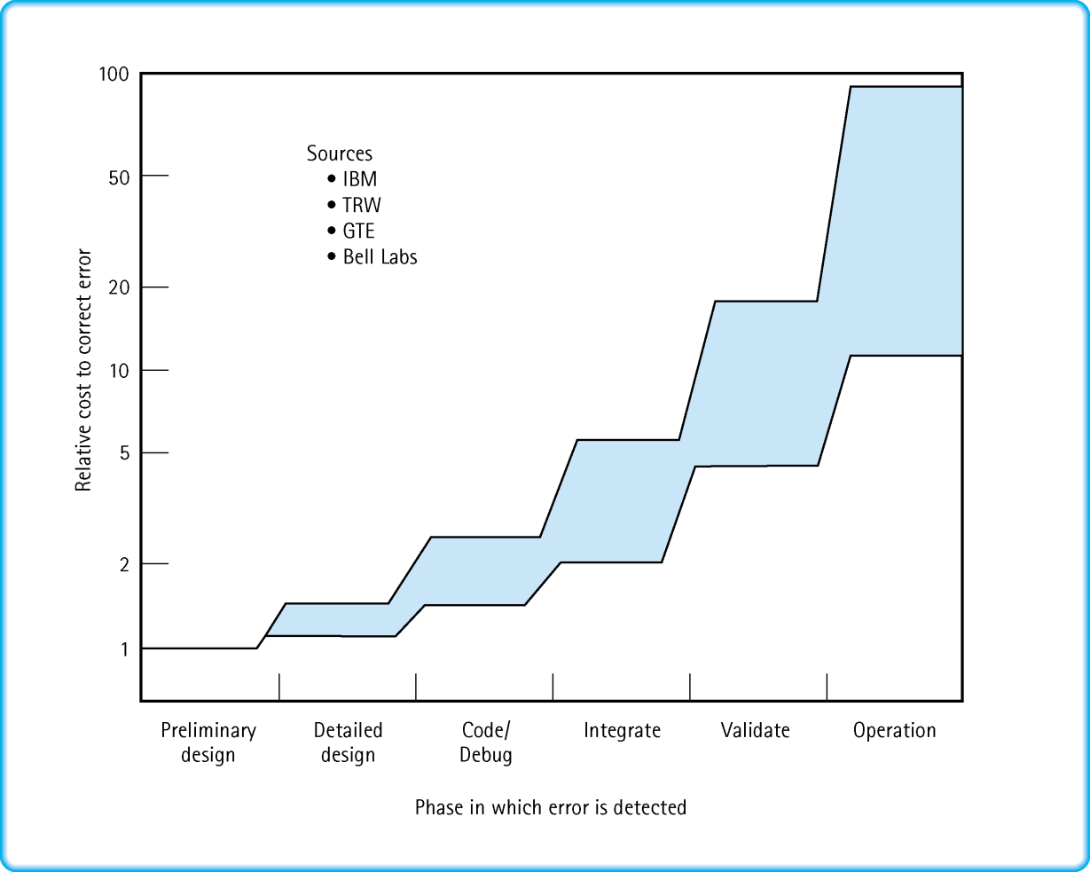
Cost of a Specification Error Based on When It Is Discovered

Slide 27
Controlling Errors
Robustness The ability of a program to recover following an error; the ability of a program to continue to operate within its environment
Preconditions Assumptions that must be true on entry into an operation or function for the postconditions to be guaranteed.
Postconditions Statements that describe what results are to be expected at the exit of an operation or function, assuming that the preconditions are true.

Slide 28
Design Review Activities
Deskchecking Tracing an execution of a design or program on paper
Walk-through A verification method in which a team performs a manual simulation of the program or design
Inspection A verification method in which one member of a team reads the program or design line by line and others point out errors

Slide 29
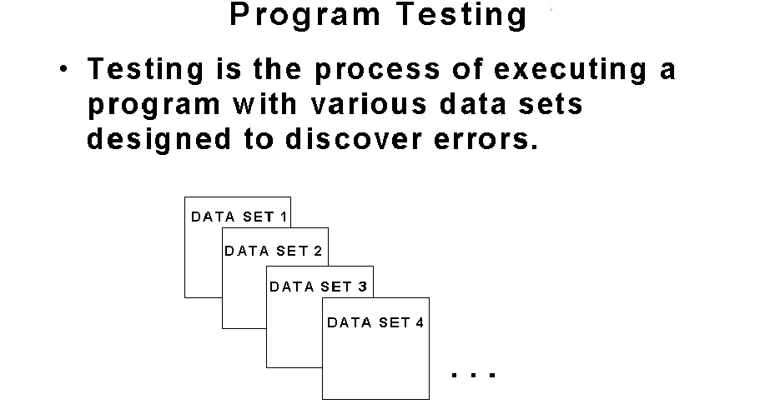
Program Testing

Slide 30
Program Testing (con't)
For Each Test Case:
  Determine inputs.
  Determine the expected behavior of the program.
  Run the program and observe the resulting behavior.
  Compare the expected behavior and the actual behavior.

Slide 31
Types of Testing
Unit testing Testing a class or function by itself
Black-box testing Testing a program or function based on the possible input values, treating the code as a “black box”
Clear (white) box testing Testing a program or function based on covering all of the branches or paths of the code

Slide 32
Integration Testing
Is performed to integrate program modules that have already been independently unit tested.
Main
Prepare
File for
Reading
Get Data
Find
Weighted
Average
Print
Weighted
Average
Print Data
Print Heading

Slide 33
Integration Testing Approaches
TOP-DOWN
BOTTOM-UP
Ensures correct overall
design logic.
Ensures individual modules
work together correctly,
beginning with the
lowest level.
USES: placeholder USES: a test driver to call
module “stubs” to test the functions being tested.
the order of calls.

Slide 34
Test Plans
Document showing the test cases planned for a program or module, their purposes, inputs, expected outputs, and criteria for success
For program testing to be effective, it must be planned.
Start planning for testing before writing a single line of code.

Slide 35
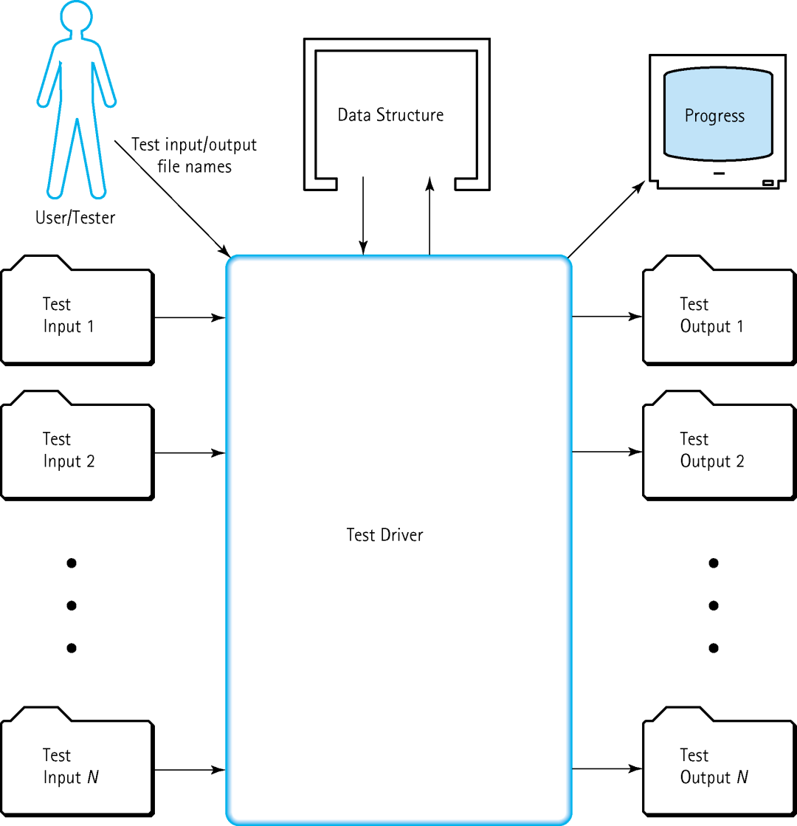
Testing C++ Structures

Slide 36
Declare an instance of the class being tested
Get name and open input file
Get name and open output file
Get label for the output file
Write the label on the output file
Read the next command from the input file
Set numCommands to 0
While the command read is not ‘quit’
Execute member function of the same name
Print the results to the output file
Increment numCommands by 1
Print “Command number” numComands “completed” to the screen
Read the next command from the input file
Close the input and output files.
Print “Testing completed” to the screen

Slide 37
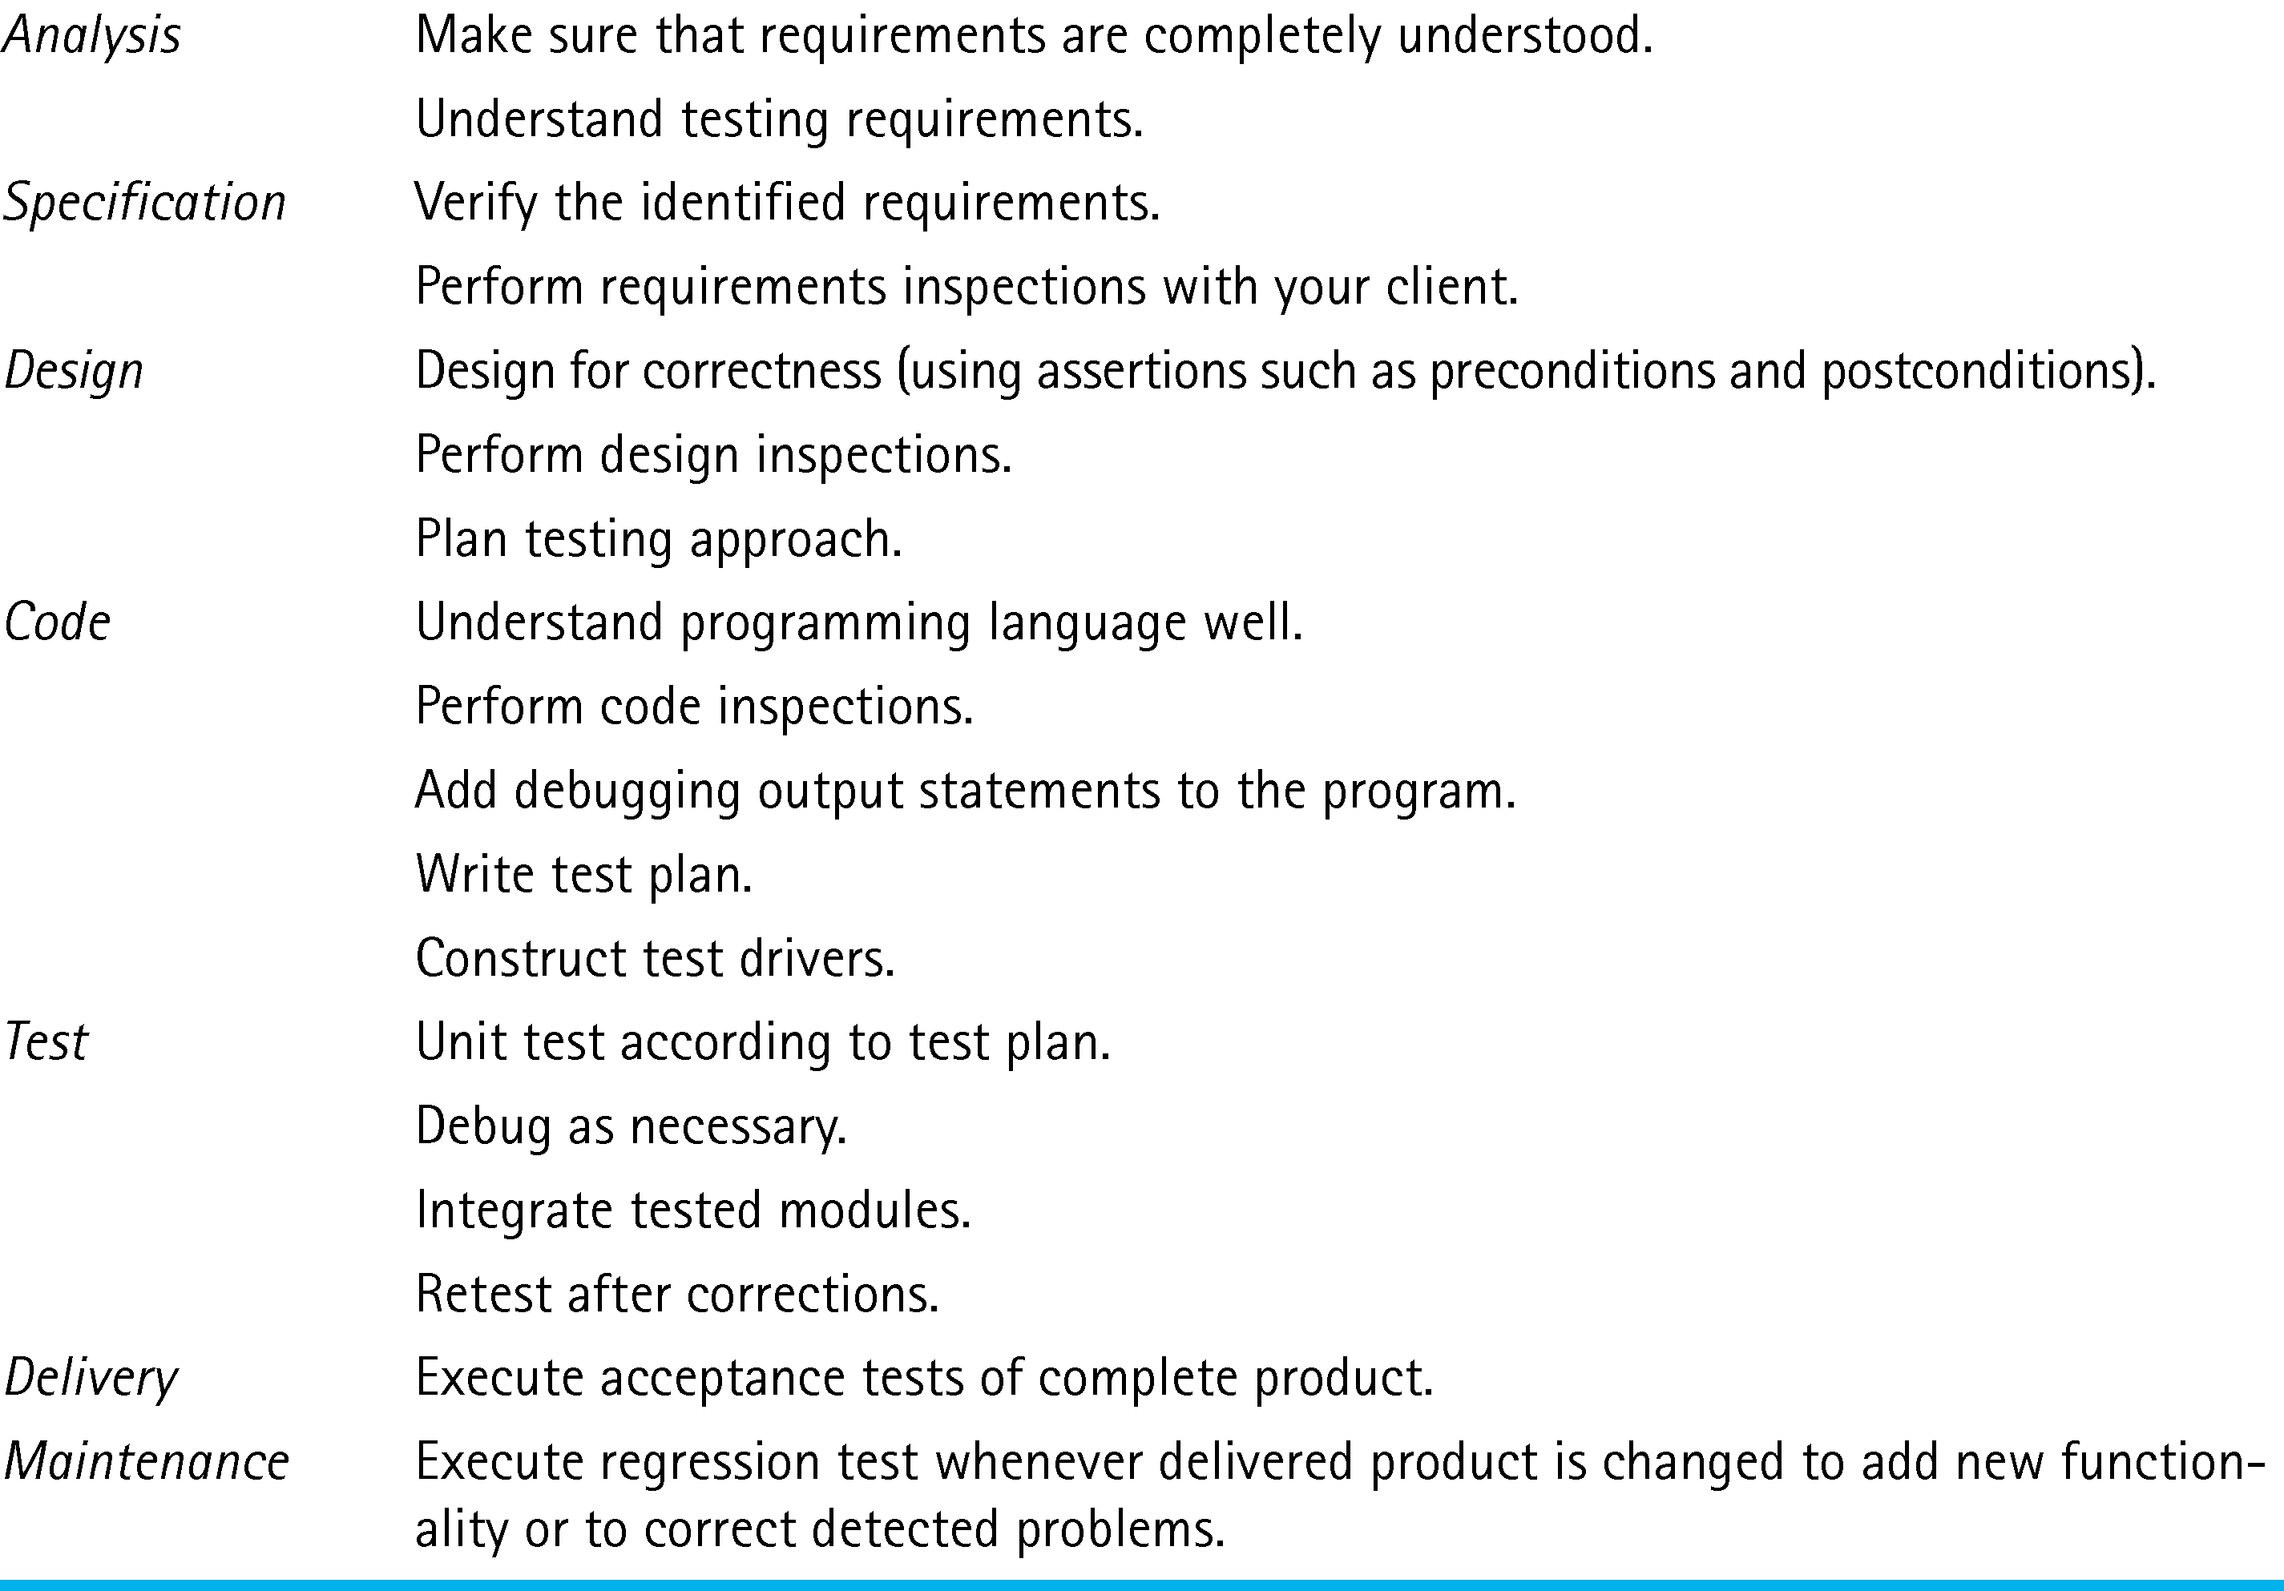
Life-Cycle Verification Activities

Slide 38
Keyboard and Screen I/O
#include <iostream>
using namespace std;
input data
output data
executing
program
Keyboard
Screen
cin
(of type istream)
cout
(of type ostream)

Slide 39
namespace
In slides that follow, assume the statement:
using namespace std;
We explain namespace in Chapter 2

Slide 40
<iostream> is header file
for a library that defines 3 objects
an istream object named cin (keyboard)
an ostream object named cout (screen)
an ostream object named cerr (screen)

Slide 41
Insertion Operator ( << )
The insertion operator << takes 2 operands.
The left operand is a stream expression, such as cout.
The right operand is an expression describing what to insert into the output stream. It may be of simple type, or a string, or a manipulator (like endl).

Slide 42
Extraction Operator ( >> )
Variable cin is predefined to denote an input stream from the standard input device ( the keyboard ).
The extraction operator >> called “get from” takes 2 operands. The left operand is a stream expression, such as cin. The right operand is a variable of simple type.
Operator >> attempts to extract the next item from the input stream and store its value in the right operand variable.

Slide 43
Extraction Operator >>
“skips” (reads but does not store anywhere)
leading whitespace characters
(blank, tab, line feed, form feed, carriage return)
before extracting the input value from the stream (keyboard or file).
To avoid skipping, use function get to read the next character in the input stream.
cin.get(inputChar);

Slide 44
#include <iostream>
int main( )
{ // USES KEYBOARD AND SCREEN I/O
using namespace std;
int partNumber;
float unitPrice;
cout << “Enter part number followed by return : “
<< endl ; // prompt
cin >> partNumber ;
cout << “Enter unit price followed by return : “
<< endl ;
cin >> unitPrice ;
cout << “Part # “ << partNumber // echo
<< “at Unit Cost: $ “ << unitPrice
<< endl ;
return 0;
}

Slide 45
Disk files for I/O
#include <fstream>
input data
output data
disk file
“myInfile.dat”
executing
program
disk file
“myOut.dat”
your variable
(of type ifstream)
your variable
(of type ofstream)

Slide 46
For File I/O
use #include <fstream>
choose valid variable identifiers for your files and declare them
open the files and associate them with disk names
use your variable identifiers with >> and <<
close the files

Slide 47
Statements for using file I/O
#include <fstream>
using namespace std;
ifstream myInfile; // declarations
ofstream myOutfile;
myInfile.open(“myIn.dat”); // open files
myOutfile.open(“myOut.dat”);
myInfile.close( ); // close files
myOutfile.close( );

Slide 48
What does opening a file do?
associates the C++ identifier for your file with the physical (disk) name for the file
if the input file does not exist on disk, open is not successful
if the output file does not exist on disk, a new file with that name is created
if the output file already exists, it is erased
places a file reading marker at the very beginning of the file, pointing to the first character in it

Slide 49
#include <fstream>
int main( )
{ // USES FILE I/O
using namespace std;
int partNumber;
float unitPrice;
ifstream inFile; // declare file variables
ofstream outFile;
inFile.open(“input.dat”); //open files
outFile.open(“output.dat”);
inFile >> partNumber ;
inFile >> unitPrice ;
outFile << “Part # “ << partNumber // echo
<< “at Unit Cost: $ “ << unitPrice << endl ;
return 0;
}

Slide 50
Stream Failure
When a stream enters the fail state, further I/O operations using that stream are ignored. But the computer does not automatically halt the program or give any error message.
Possible reasons for entering fail state include:
  invalid input data (often the wrong type)
  opening an input file that doesn’t exist
  opening an output file on a disk that is already full or is write-protected.

Slide 51
#include <fstream>
#include <iostream>
using namespace std;
int main( )
{ // CHECKS FOR STREAM FAIL STATE
ifstream inFile;
inFile.open(“input.dat”); // try to open file
if ( !inFile )
{
cout << “File input.dat could not be opened.”;
return 1;
}
. . .
return 0;
}

